Slide 1

Continuously Reasoning about Programs
using Differential Bayesian Inference
Kihong Heo · Mukund Raghothaman · Xujie Si · Mayur Naik
University of Pennsylvania

Slide 2
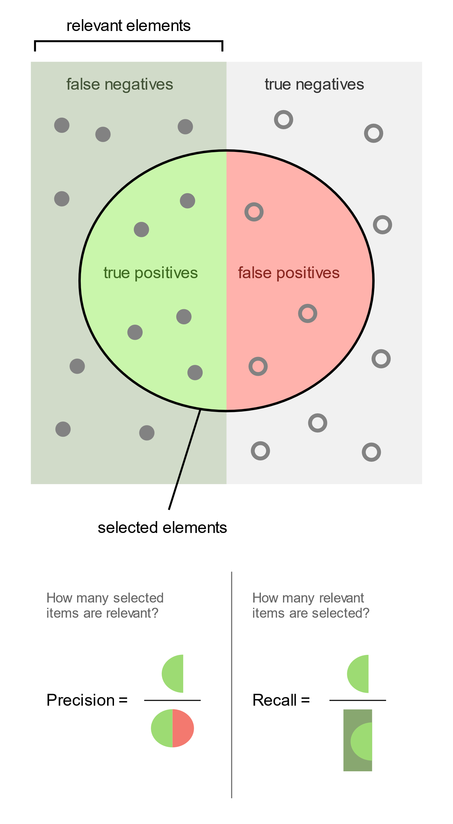
Traditional Goals of Static Analyses
Accuracy
Running time
Solutions:
Designing better abstractions
Developing efficient algorithms
Learning bug patterns
Memory use

Slide 3


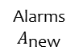
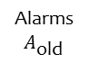
Verifying Continuously Evolving Programs
Programs continuously being updated: new features, bug fixes
Individual commits only touch small portion of entire program
Old Version
Source code
Alarms $A_{\text{old}}$
#include <stdio
int main() {
int x = ⋯;
int *y = &x;
*y = ⋯;
}
Analysis
…
…
…
Δ
“Does this commit introduce any bugs?!”
New Version
#include <stdio
int main() {
int x = ⋯;
int *y = &x;
*y = ⋯;
}
Analysis
…
…
…
Source code
Alarms $A_{\text{new}}$
Notes:
Make speech box font bigger

Slide 4




Verifying Continuously Evolving Programs
“We only display results for most analyses on changed lines by default; this keeps analysis results relevant to the code review at hand.”
―Sadowski et al., ICSE 2015
“… is the ability to analyze a commit rather than the entire codebase. This functionality can help developers assess the quality and impact of a change.”
―Christakis et al., ASE 2016
“The vast majority of Infer’s impact to this point is attributable to continuous reasoning at diff time.”
―O’Hearn, LICS 2018
“… verification must continue to work with low effort as developers change the code. Neither of these approaches would work for Amazon as s2n is under continuous development.”
―Chudnov et al., CAV 2018

Slide 5
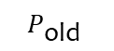
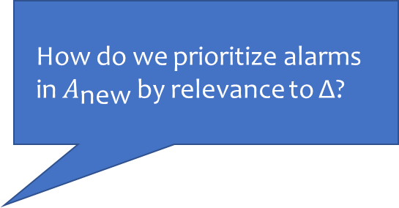
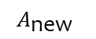
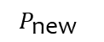
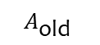
Central Question of this Talk
$$P_{\text{old}}$$
$$P_{\text{new}}$$
Δ
#include <stdi
int main() {
int x = ⋯;
int *y = &x;
*y = ⋯;
}
#include <stdi
int main() {
int x = ⋯;
int *y = &x;
*y = ⋯;
}
Outline:
Problem description
Differential derivation graph
Experimental effectiveness
Conclusion
Outline:
Problem description
Differential derivation graph
Experimental effectiveness
Conclusion
How do we prioritize alarms in $A_{\text{new}}$ by relevance to Δ?
Analysis
Analysis
Alarm(⋯)
Alarm(⋯)
⋮
Alarm(⋯)
Alarm(⋯)
⋮
$$A_{\text{old}}$$
$$A_{\text{new}}$$
Notes:
TODO: Fix Delta spacing
Which alarms are relevant to Δ, and which are not?
Furthermore, identifying the shades of grey in between.

Slide 6
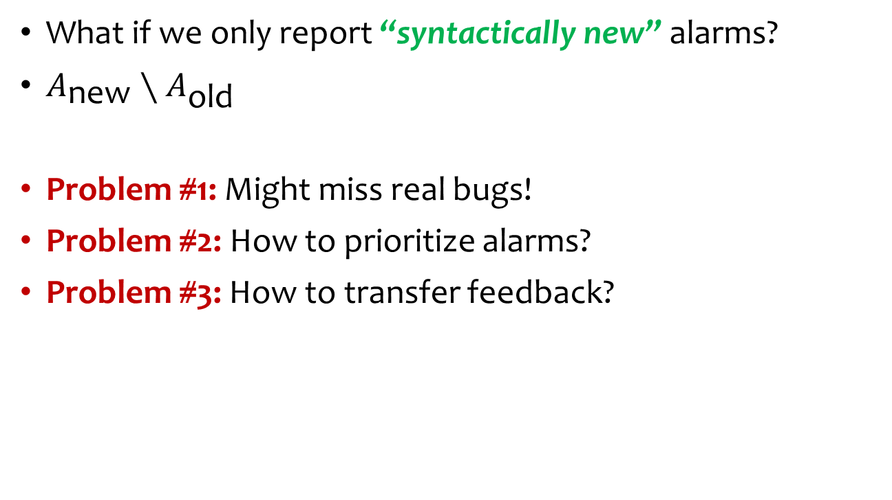
Tentative Solution: Syntactic Masking Problem #1: Might miss real bugs!
What if we only report “syntactically new” alarms?
$A_{\text{new}}∖A_{\text{old}}$
Problem #1: Might miss real bugs!
Problem #2: How to prioritize alarms?
Problem #3: How to transfer feedback?
$$P_{\text{old}}$$
$$P_{\text{new}}$$
Δ
#include <stdi
int main() {
int x = ⋯;
int *y = &x;
*y = ⋯;
}
#include <stdi
int main() {
int x = ⋯;
int *y = &x;
*y = ⋯;
}
How do we prioritize alarms in $A_{\text{new}}$ by relevance to Δ?
Analysis
Analysis
Alarm(⋯)
Alarm(⋯)
⋮
Alarm(⋯)
Alarm(⋯)
⋮
$$A_{\text{old}}$$
$$A_{\text{new}}$$

Slide 7

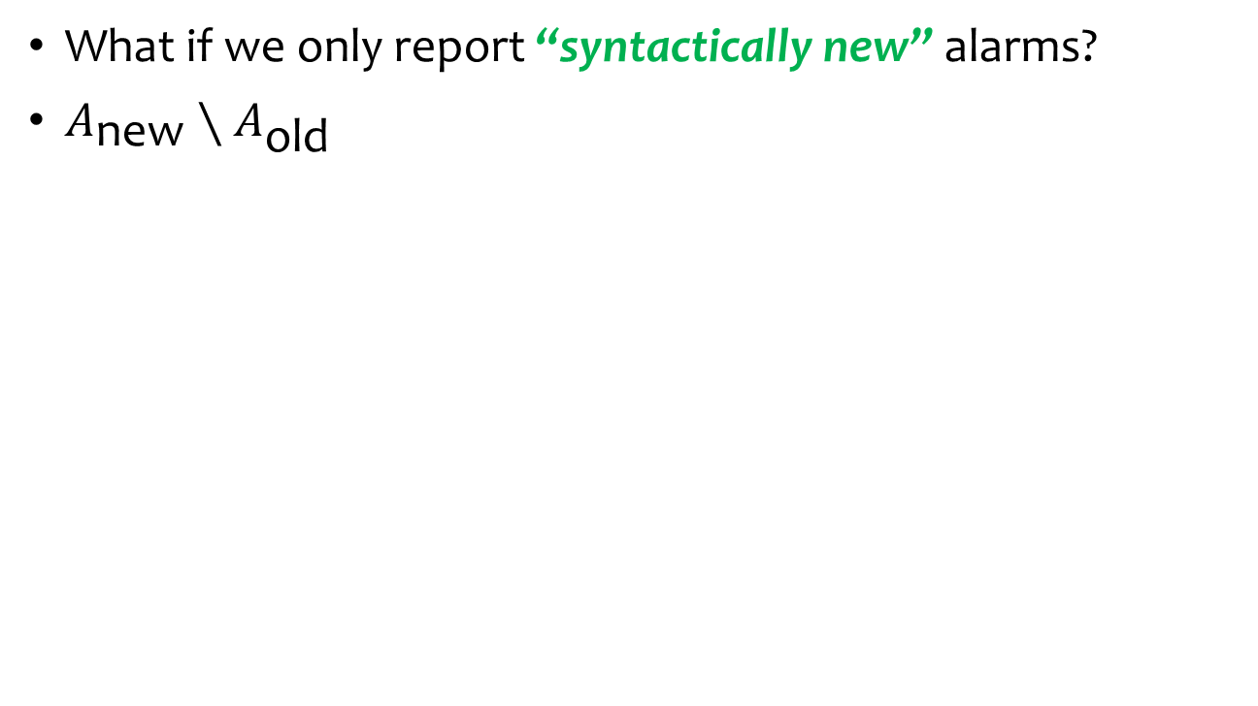
Tentative Solution: Syntactic Masking Problem #1: Might miss real bugs!
What if we only report “syntactically new” alarms?
$A_{\text{new}}∖A_{\text{old}}$
$$P_{\text{old}}$$
$$P_{\text{new}}$$
Δ
#include <stdi
int main() {
int x = ⋯;
int *y = &x;
*y = ⋯;
}
#include <stdi
int main() {
int x = ⋯;
int *y = &x;
*y = ⋯;
}
Use diff to identify common syntactic elements
O₁: int getSize() {
O₂: int samples = readInt();
O₃: int size = min(samples, 529200);
O₄: int extra = 32;
O₅: int total = size + extra;
O₆: return total;
O₇: }
O₈: malloc(2 * getSize());
N₁: int getSize() {
N₂: int samples = readInt();
N₃: int size = min(samples, 529200);
N₄: int shift = readInt();
N₅: int extra = 32 + shift;
N₆: int total = size + extra;
N₇: return total;
N₈: }
N₉: malloc(2 * getSize());
N₁: int getSize() {
N₂: int samples = readInt();
N₃: int size = min(samples, 529200);
O₄: int extra = 32;
N₆: int total = size + extra;
N₇: return total;
N₈: }
N₉: malloc(2 * getSize());
O₁: int getSize() {
O₂: int samples = readInt();
O₃: int size = min(samples, 529200);
O₄: int extra = 32;
O₅: int total = size + extra;
O₆: return total;
O₇: }
O₈: malloc(2 * getSize());
Analysis
Analysis
-
+
+
-
Alarm(⋯)
Alarm(⋯)
⋮
Alarm(⋯)
Alarm(⋯)
⋮
✔
Alarm(O₈)
Alarm(O₈)
$$A_{\text{old}}$$
$$A_{\text{new}}$$
Alarm(N₉)
Alarm(N₉)

Slide 8
Question: Which alarms do we report?
Solution: Consider full “alarm provenance”
Solution: Prioritize alarms with new derivation trees
Common to both versions
Unique to new version
edge(N₂, N₃)
edge(N₄, N₅)
N₁: int getSize() {
N₂: int samples = readInt();
N₃: int size = min(samples, 529200);
O₄: int extra = 32;
N₆: int total = size + extra;
N₇: return total;
N₈: }
N₉: malloc(2 * getSize());
N₁: int getSize() {
N₂: int samples = readInt();
N₃: int size = min(samples, 529200);
N₄: int shift = readInt();
N₅: int extra = 32 + shift;
N₆: int total = size + extra;
N₇: return total;
N₈: }
N₉: malloc(2 * getSize());
path(N₂, N₃)
edge(N₃, N₆)
path(N₄, N₃)
edge(N₃, N₆)
path(N₂, N₆)
edge(N₆, N₇)
path(N₄, N₆)
edge(N₆, N₇)
+
+
-
path(N₂, N₇)
edge(N₇, N₉)
path(N₄, N₇)
edge(N₇, N₉)
path(N₂, N₉)
Src(N₂)
Sink(N₉)
✔
path(N₄, N₉)
Src(N₄)
Sink(N₉)
Alarm(N₉)
Alarm(N₉)
Alarm(N₉)
Alarm(N₉)

Slide 9
Contributions
Solution: Consider full “alarm provenance”
Solution: Prioritize alarms with new derivation trees
Contribution 1: Algorithm which
Contribution 1: 1. identifies alarms with new derivation trees,
Contribution 1: 2. interactively ranks alarms by relevance, and
Contribution 1: 3. enables feedback transfer across versions
Contribution 2: Publicly available implementation named Drake

Slide 10

Drake System Architecture
Differential Derivation Graph
Old Version
Source code
Derivation graph
Partially labelled alarms
#include <stdi
int main() {
int x = ⋯;
int *y = &x;
*y = ⋯;
}
Analysis
? …
✘ …
✔ …
✔ …
✘ …
✘ …
Δ
Marginal Inference
New Version
…
…
…
#include <stdi
int main() {
int x = ⋯;
int *y = &x;
*y = ⋯;
}
Analysis
Ranked alarms
Source code
Derivation graph
Bingo (PLDI 2018)

Slide 11
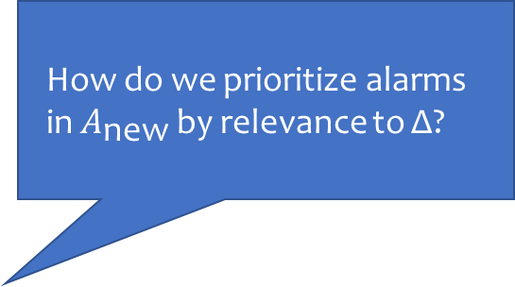
Our Approach
$$P_{\text{old}}$$
$$P_{\text{new}}$$
#include <stdi
int main() {
int x = ⋯;
int *y = &x;
*y = ⋯;
}
Δ
#include <stdi
int main() {
int x = ⋯;
int *y = &x;
*y = ⋯;
}
Outline:
Problem description
Differential derivation graph
Experimental effectiveness
Conclusion
Outline:
Problem description
Differential derivation graph
Experimental effectiveness
Conclusion
How do we prioritize alarms in $A_{\text{new}}$ by relevance to Δ?
Analysis
Analysis
Alarm(⋯)
Alarm(⋯)
⋮
Alarm(⋯)
Alarm(⋯)
⋮
$$A_{\text{old}}$$
$$A_{\text{new}}$$
Notes:
Which alarms are relevant to Δ, and which are not?
Furthermore, identifying the shades of grey in between.

Slide 12
The Differential Derivation Graph
Old Version
Source code
Derivation graph
Partially labelled alarms
#include <stdi
int main() {
int x = ⋯;
int *y = &x;
*y = ⋯;
}
Analysis
? …
✘ …
✔ …
✔ …
✘ …
✘ …
“Explanations” obtained by instrumenting the analysis
Δ
Marginal Inference
New Version
…
…
…
#include <stdi
int main() {
int x = ⋯;
int *y = &x;
*y = ⋯;
}
Analysis
Ranked alarms
Source code
Derivation graph
Bingo (PLDI 2018)
Notes:
FC->DG

Slide 13
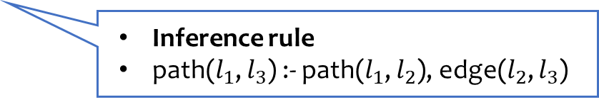
Prioritizing Alarms with Changed Provenance
Solution: Consider full “alarm provenance”
Solution: Prioritize alarms with new derivation trees
edge(N₂, N₃)
path(N₂, N₃)
edge(N₃, N₆)
path(N₂, N₃)
edge(N₃, N₆)
path(N₂, N₃)
edge(N₃, N₆)
R
path(N₂, N₆)
path(N₂, N₆)
edge(N₆, N₇)
Inference rule
path($l_{1}$, $l_{3}$) :- path($l_{1}$, $l_{2}$), edge($l_{2}$, $l_{3}$)
path(N₂, N₇)
edge(N₇, N₉)
path(N₂, N₆)
path(N₂, N₉)
Src(N₂)
Sink(N₉)
Alarm(N₉)

Slide 14
Prioritizing Alarms with Changed Provenance
Solution: Consider full “alarm provenance”
Solution: Prioritize alarms with new derivation trees
path(N₂, N₃)
edge(N₃, N₆)
path_{α}(N₂, N₃)
path_{β}(N₂, N₃)
edge_{α}(N₃, N₆)
edge_{β}(N₃, N₆)
Derived using exclusively old means
R
R_{αα}
R_{αβ}
R_{βα}
R_{ββ}
path(N₂, N₆)
path_{α}(N₂, N₆)
path_{β}(N₂, N₆)
path_{β} indicates use of new element
Split every conclusion
reached by the analysis
α: Derivations using only elements common to both
β: Derivable iff path(N₂, N₆) admits at least one new tree
β: Derivations using at least one element of new version

Slide 15
Prioritizing Alarms with Changed Provenance
Solution: Consider full “alarm provenance”
Solution: Prioritize alarms with new derivation trees
✔ …
✘ …
✘ …
path(N₂, N₃)
edge(N₃, N₆)
path_{α}(N₂, N₃)
path_{β}(N₂, N₃)
edge_{α}(N₃, N₆)
edge_{β}(N₃, N₆)
Marginal Inference
R
R_{αα}
R_{αβ}
R_{βα}
R_{ββ}
path(N₂, N₆)
path_{α}(N₂, N₆)
path_{β}(N₂, N₆)
…
…
…
path_{β} indicates use of new element
Ranked alarms
Split every conclusion
reached by the analysis
α: Derivations using only elements common to both
β: Derivable iff path(N₂, N₆) admits at least one new tree
β: Derivations using at least one element of new version
Bingo (PLDI 2018)

Slide 16
Central Question of this Talk
$$P_{\text{old}}$$
$$P_{\text{new}}$$
#include <stdi
int main() {
int x = ⋯;
int *y = &x;
*y = ⋯;
}
Δ
#include <stdi
int main() {
int x = ⋯;
int *y = &x;
*y = ⋯;
}
Outline:
Problem description
Differential derivation graph
Experimental effectiveness
Conclusion
Outline:
Problem description
Differential derivation graph
Experimental effectiveness
Conclusion
How do we prioritize alarms in $A_{\text{new}}$ by relevance to Δ?
Analysis
Analysis
Alarm(⋯)
Alarm(⋯)
⋮
Alarm(⋯)
Alarm(⋯)
⋮
$$A_{\text{old}}$$
$$A_{\text{new}}$$
Notes:
Which alarms are relevant to Δ, and which are not?
Furthermore, identifying the shades of grey in between.

Slide 17


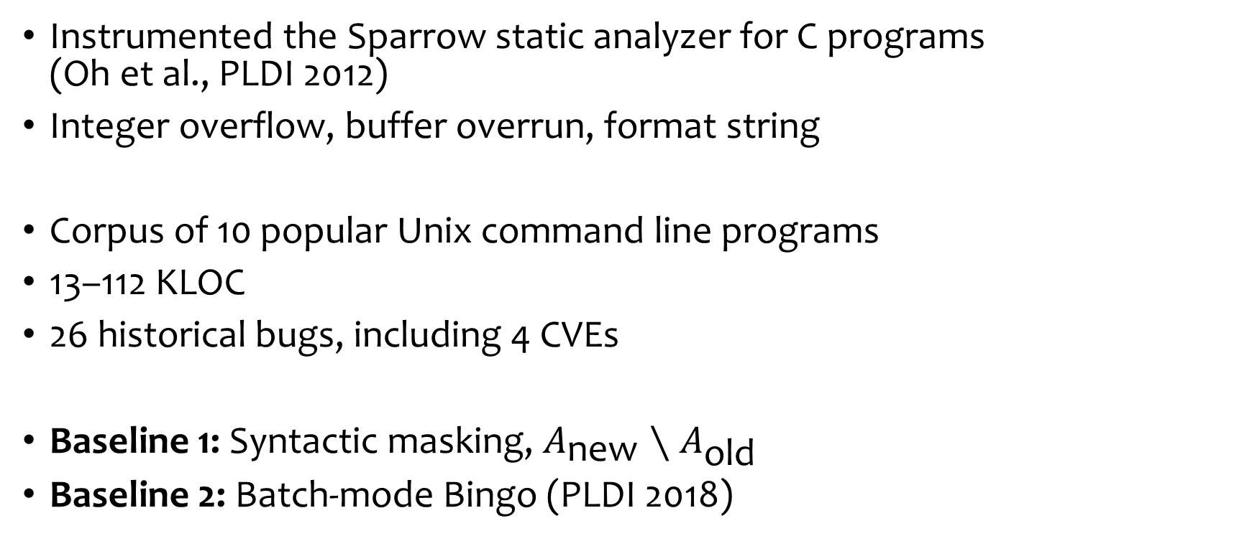
Experimental Setup
Instrumented the Sparrow static analyzer for C programs (Oh et al., PLDI 2012)
Integer overflow, buffer overrun, format string
Corpus of 10 popular Unix command line programs
13–112 KLOC
26 historical bugs, including 4 CVEs
Baseline 1: Syntactic masking, $A_{\text{new}}∖A_{\text{old}}$
Baseline 2: Batch-mode Bingo (PLDI 2018)

Slide 18
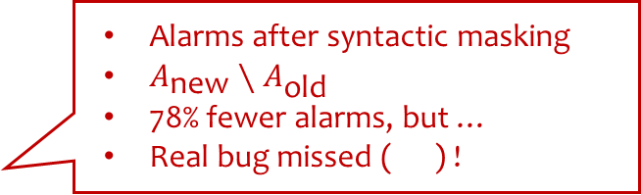
Experimental Effectiveness
The Case of grep (V2.18 → V2.19) (V
68 KLOC, 7% changed during version bump
Buffer overrun vulnerability introduced (CVE-2015-1345)
“Successful attacks will allow attackers to execute arbitrary code …” ―Symantec
Alarms reported by the Sparrow static analyzer (Oh et al., PLDI 2012)
The Case of grep (V2.18 → V2.19) (V
68 KLOC, 7% changed during version bump
Buffer overrun vulnerability introduced (CVE-2015-1345)
“Successful attacks will allow attackers to execute arbitrary code …” ―Symantec
Alarms after syntactic masking
$A_{\text{new}}∖A_{\text{old}}$
78% fewer alarms, but …
Real bug missed ( ) !
Batch-mode interactive prioritization
Drake (this paper): Bug discovered within just 9 rounds of interaction!

Slide 19
Experimental Effectiveness
Bingo (Average rounds of interaction to find all bugs)
Drake
Interactive
85
30
Average number of alarms per program
Syntactic alarm masking
Non-interactive
563
118
(+ 4 )
Batch
Relevance-aware

Slide 20
Our Approach
$$P_{\text{old}}$$
$$P_{\text{new}}$$
#include <stdi
int main() {
int x = ⋯;
int *y = &x;
*y = ⋯;
}
Δ
#include <stdi
int main() {
int x = ⋯;
int *y = &x;
*y = ⋯;
}
Outline:
Problem description
Differential derivation graph
Experimental effectiveness
Conclusion
Outline:
Problem description
Differential derivation graph
Experimental effectiveness
Conclusion
How do we prioritize alarms in $A_{\text{new}}$ by relevance to Δ?
Analysis
Analysis
Alarm(⋯)
Alarm(⋯)
⋮
Alarm(⋯)
Alarm(⋯)
⋮
$$A_{\text{old}}$$
$$A_{\text{new}}$$
Notes:
Which alarms are relevant to Δ, and which are not?
Furthermore, identifying the shades of grey in between.

Slide 21
Conclusion
New challenges while applying static analysis tools to large software
Measures beyond accuracy: relevance, severity, …
System to prioritize alarms during continuous integration
Dramatic effectiveness in reducing alarm inspection burden
In the paper:
General alarm differencing framework for Datalog
Formal descriptions of algorithm and proofs
Detailed experimental evaluation

Slide 22
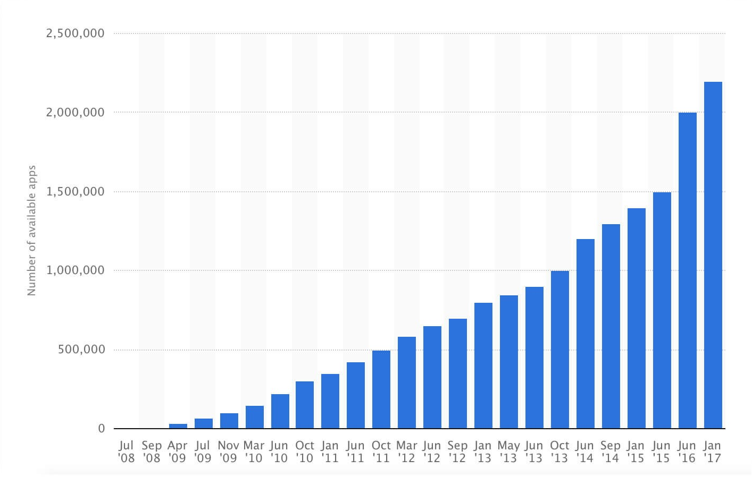
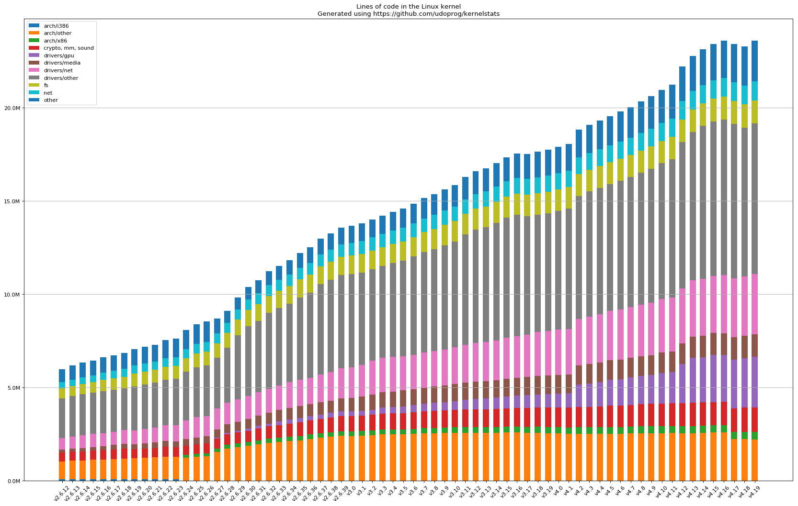
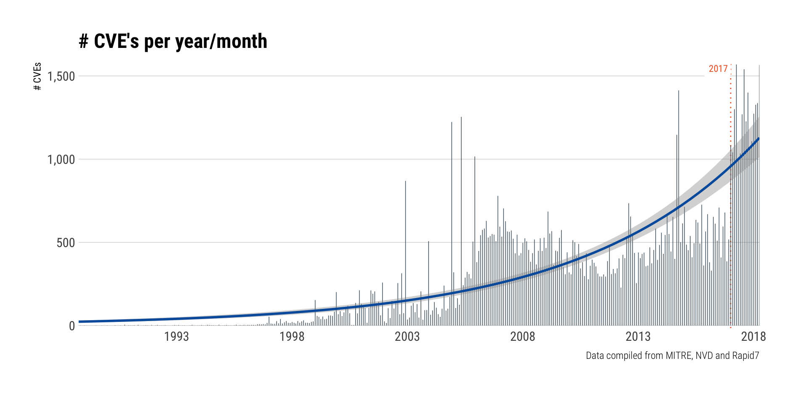





Expanding Scope and Complexity of Software
Apps on the App Store
Linux Kernel SLOC
Rate of CVEs being reported

Slide 23



Growing Adoption of Formal Verification Tools
Astrée
Airbus
Microsoft
SonarSource
Synopsis
Amazon
Facebook
Uber

Slide 24
Drake Benchmarks
10 popular Unix command-line utilities
13–112 KLOC
26 historical bugs, including 4 CVEs
“Change is small relative to program size”
Program | Version |  | Size (KLOC) |  | Δ (%) | # Bugs | Type
 | Old | New | Old | New
shntool | 3.0.4 | 3.0.5 | 13 | 13 | 1 | 6 | Int. ovfl.
latex2rtf | 2.1.0 | 2.1.1 | 27 | 27 | 3 | 2 | Fmt. str.
urjtag | 0.7 | 0.8 | 45 | 46 | 18 | 6 | Fmt. str.
optipng | 0.5.2 | 0.5.3 | 60 | 61 | 2 | 1 | Int. ovfl.
wget | 1.11.4 | 1.12 | 42 | 65 | 47 | 6 | Bfr. ovrn.
readelf | 2.23.2 | 2.24 | 63 | 65 | 6 | 1 | Bfr. ovrn.
grep | 2.18 | 2.19 | 68 | 68 | 7 | 1 | Bfr. ovrn.
sed | 4.2.2 | 4.3 | 48 | 83 | 40 | 1 | Bfr. ovrn.
sort | 7.1 | 7.2 | 96 | 98 | 3 | 1 | Bfr. ovrn.
tar | 1.27 | 1.28 | 108 | 112 | 4 | 1 | Bfr. ovrn.
Avg:
13%

